Slide 1

Introduction to a Docker

Slide 2
Learning objectives
You should understand what Docker is
You should understand how to create Docker images
You should understand how to map ports between Docker and the Host OS
You should understand the basics of Docker networking
You should understand how to use volumes for persistent storage
You should be able to tag images

Slide 3
What is Docker
Docker architecture
Installation
Creating containers
Images vs containers
Images from the Dockerfile
Images from Containers
Port mapping
Networking
Volumes
Tagging
Introduction to Docker

Slide 4
What is Docker?

Slide 5
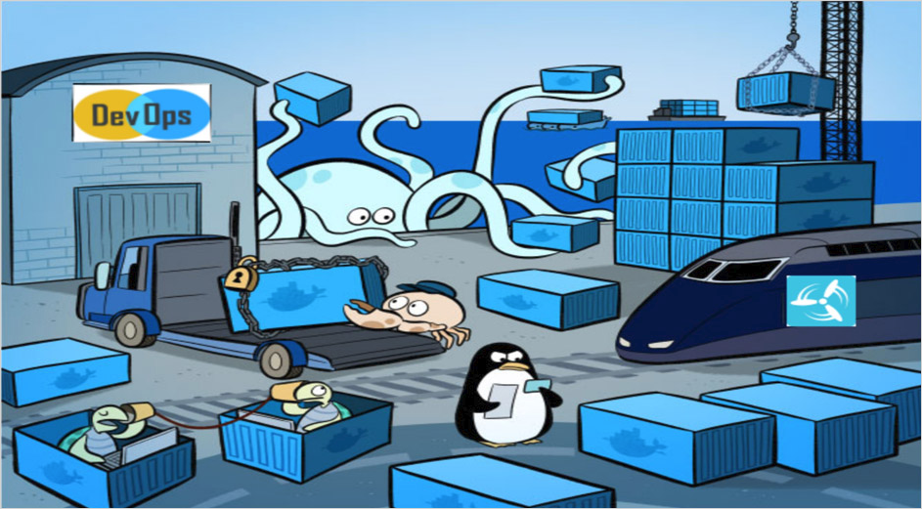
Docker is a container platform that allows you to separate your application from the underlying infrastructure by bundling up your code and all of its dependencies into a self-contained entity that will run the same on any supported system.

Slide 6

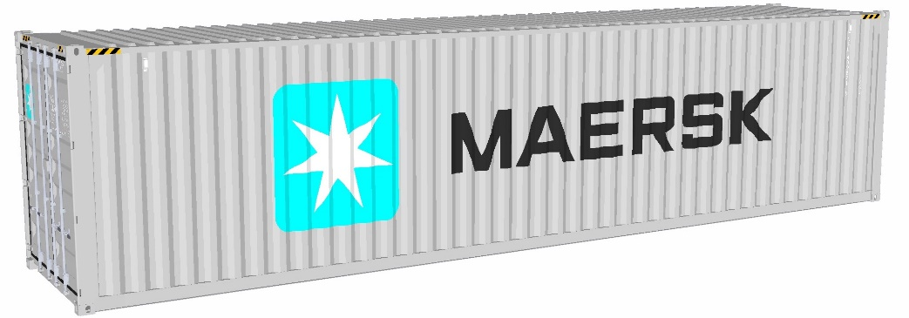
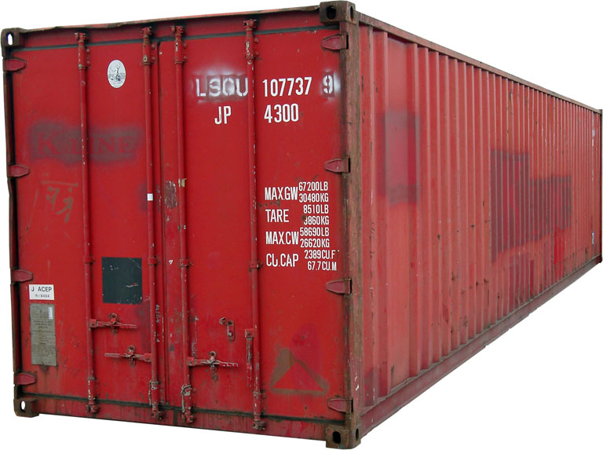
This Photo by Unknown Author is licensed under CC BY-SA

Slide 7
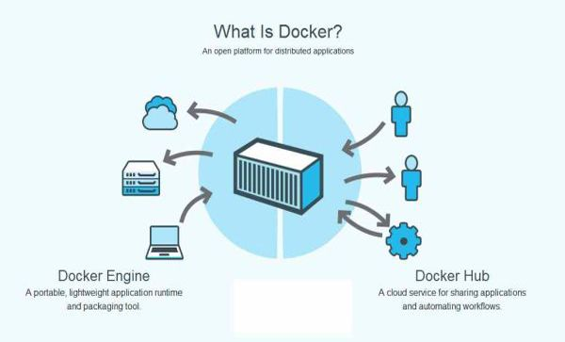
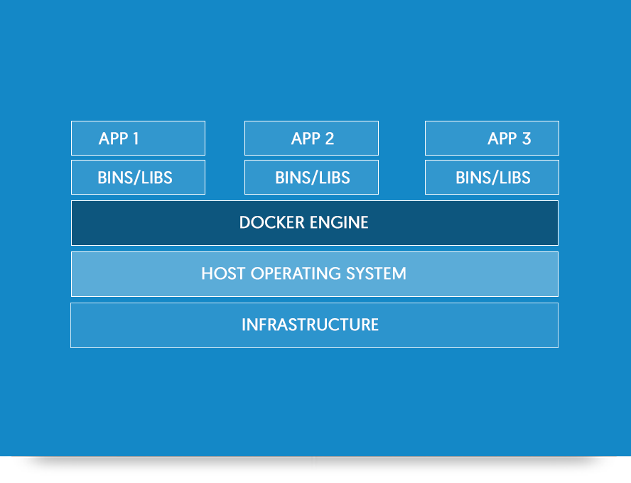
This Photo by Unknown Author is licensed under CC BY-SA

Slide 8
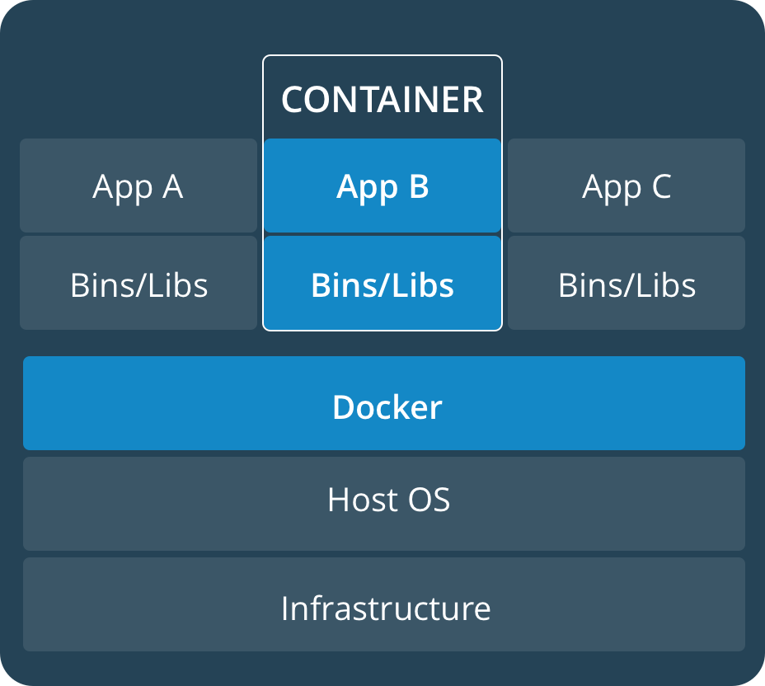
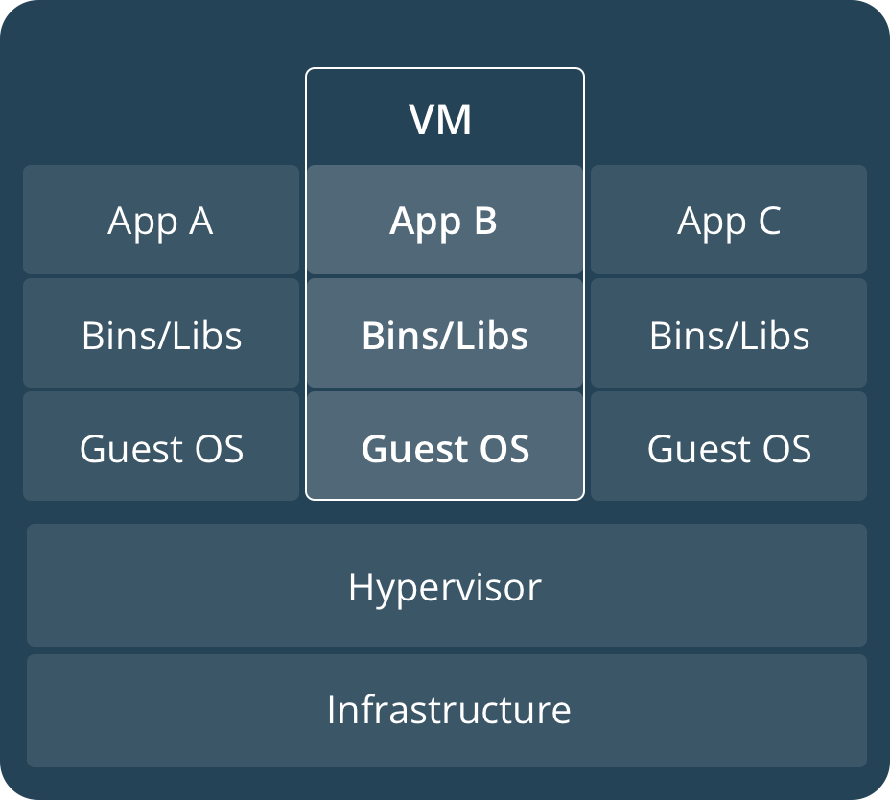

Slide 9
Containerization is increasingly popular because containers are:
Flexible: Even the most complex applications can be containerized.
Lightweight: Containers leverage and share the host kernel.
Interchangeable: You can deploy updates and upgrades on-the-fly.
Portable: You can build locally, deploy to the cloud, and run anywhere.
Scalable: You can increase and automatically distribute container replicas.
Stackable: You can stack services vertically and on-the-fly.

Slide 10

Docker architecture

Slide 11
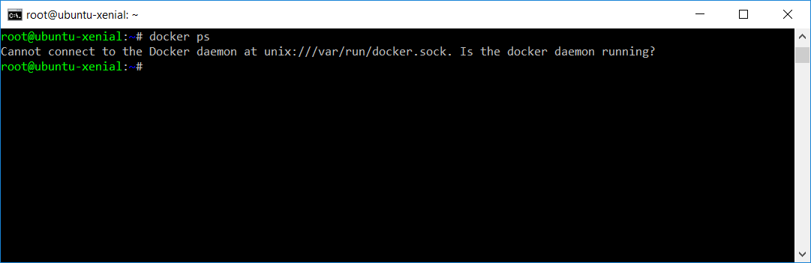
Docker architecture

Slide 12
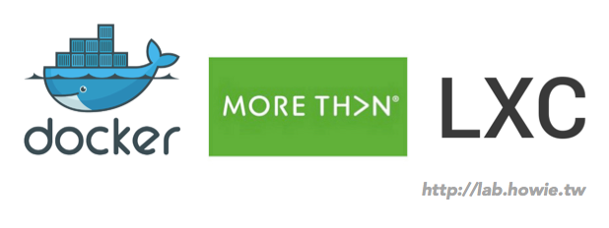
Containers(LXC) aren’t new! Dockers just made them popular.

Slide 13
Namespaces:
The pid namespace: Process isolation (PID: Process ID).
The net namespace: Managing network interfaces (NET: Networking).
The ipc namespace: Managing access to IPC resources (IPC: InterProcess Communication).
The mnt namespace: Managing filesystem mount points (MNT: Mount).
The uts namespace: Isolating kernel and version identifiers. (UTS: Unix Timesharing System).

Slide 14
Control groups:
Resource limiting: groups can be set to not extend a configured memory limit
Prioritization: some groups may get larger share of CPU utilization or disk I/O throughput
Accounting: measures a group resource usage
Control: freezing groups of process

Slide 15
UnionFS:
Merging: overlay filesystem branches to merge changes
Read\Write: branches can be read-only or read-write

Slide 16
Docker Installation
Uninstall old versions
Install from a package
$ apt-get remove docker docker-engine docker.io
Set up the repository
Go to https://download.docker.com/linux/ubuntu/dists/
$ apt-get update
$ apt-get install \ apt-transport-https ca-certificates \
curl software-properties-common
$ dpkg -i /path/to/package.deb
$ sudo docker run hello-world
$ curl -fsSL https://download.docker.com/linux/ubuntu/gpg | apt-key add -
$ apt-key fingerprint 0EBFCD88
$ sudo add-apt-repository \ "deb [arch=amd64] https://download.docker.com/linux/ubuntu \
$(lsb_release -cs) \ stable"
Install Docker CE
$ apt-get update
$ apt-get install docker-ce
$ sudo docker run hello-world

Slide 17
Overview
Docker Compose files
Docker Compose CLI
Running Web Apps
Building images with Compose
Multi-environment Compose
Manage Application with Docker Compose

Slide 18
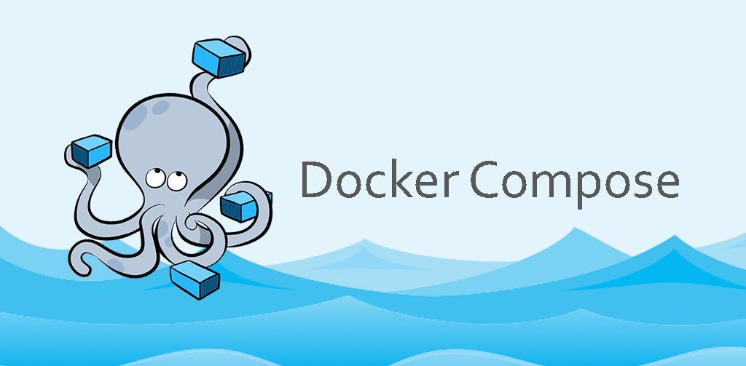
What is Docker Compose
Motivation
Parts of Compose

Slide 19
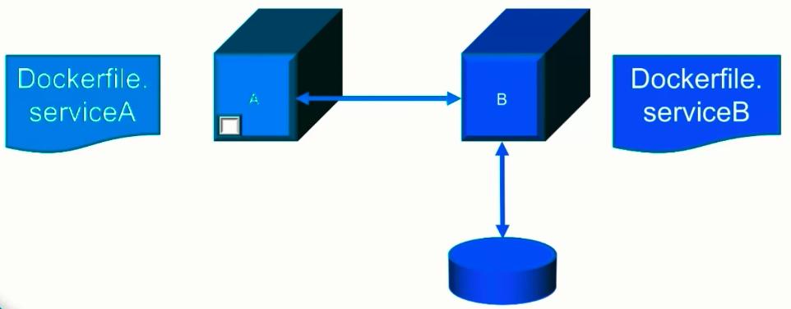
How do you create this environment?

Slide 20
Create the test environment
$ docker network create --driver bridge app_network $ docker volume create serviceB_volume
$ docker build -f Dockerfile.serviceA . $ docker build -f Dockerfile.serviceB .

Slide 21
Create the test environment
$ docker run -d –name serviceA \ --network app_network \ -p 8080:3000 \ serviceA
$ docker run -d --name serviceB \ --network app_network \ --mount source= serviceB_volume,target=/data \ serviceB

Slide 22
Tear down the test environment
$ docker stop serviceA serviceB $ docker rm serviceA serviceB $ docker rmi serviceA serviceB $ docker volume rm serviceB_volume $ docker network rm app_network

Slide 23
Can we do better?
spin_up.sh
tear_down.sh

Slide 24
Docker Compose
Manage multi-container environments Take a declarative, as opposed to an imperative, approach and let some tooling figure out the steps to create what you want. …

Slide 25
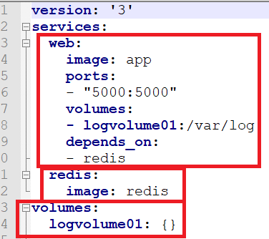
Compose File Preview

